Slide 1

SCHOOL MANAGEMENT SYSTEM
Capstone project:
CSA0937-Programming in Java and Analysis
TEAM:
P Tejasree – 192110440
SUPERVISOR:
DR M Buvanesvari

Slide 2
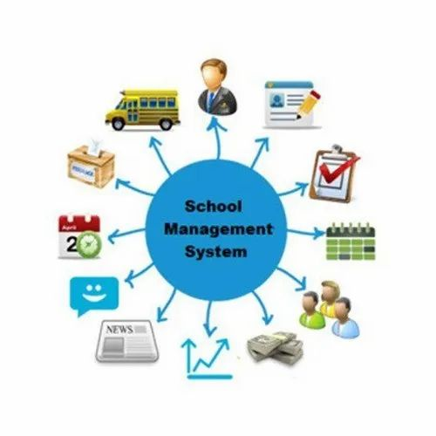
OBJECTIVE:
The goal of a school management system is to improve and expedite the operational, academic, and administrative procedures in educational establishments. Its main goal is to increase productivity through the digitization and automation of processes like resource management, schedule scheduling, grade recording, attendance tracking, and student enrolment.

Slide 3
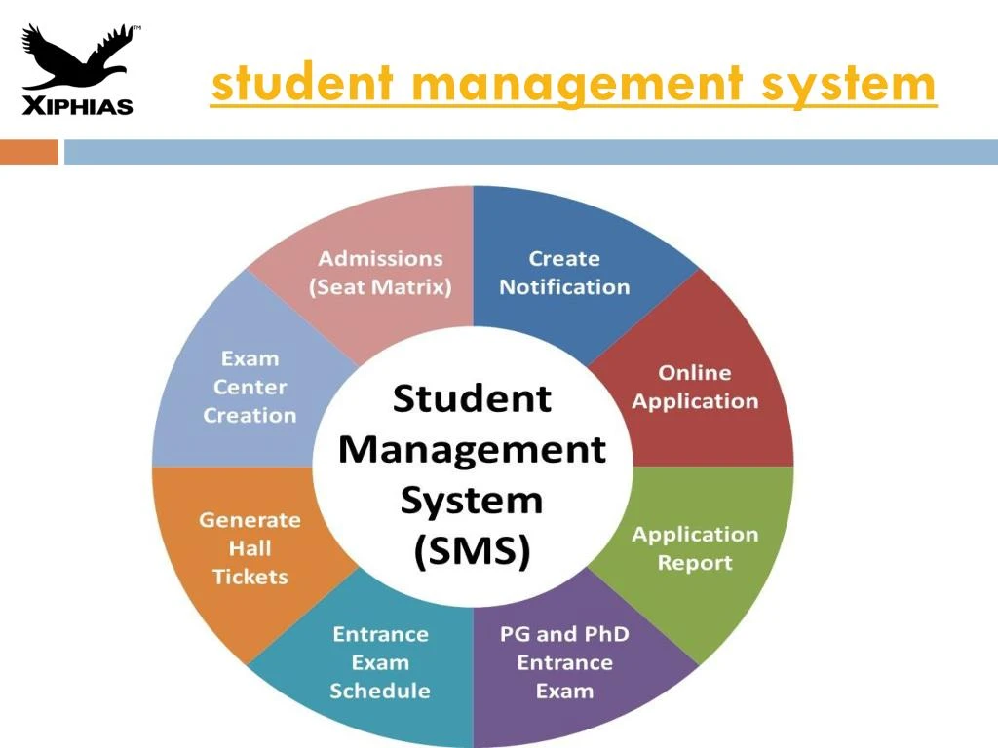
INTRODUCTION:
Efficient student registration and class administration procedures are made possible by a complete school management system, which also guarantees precise tracking of attendance and academic records.The class management feature of the system enables administrators to place students in particular classes according to their grade level, course prerequisites, and availability after they have enrolled.

Slide 4

By offering user-friendly interfaces for class selection and enrollment, the system expedites this procedure and guarantees that students are enrolled in courses that will best support their academic progress and aspirations.The system has strong attendance monitoring features in addition to class management to keep an eye on student participation and attendance. Teachers can use digital interfaces to record student attendance in real-time through the system's attendance module, doing away with the requirement for paper attendance forms and lowering the possibility of mistakes or inconsistencies. After that, administrators have access to attendance data and can create reports to spot trends, patterns, and areas where student engagement and attendance need to be improved.

Slide 5
LITERATURE SURVEY:
"Academic journals And papers Design and implementation of school management system" by Adebesin, F. and Ogunlade, O. This paper proposes a system that uses Student management system to automate attendance management. It discusses the implementation details and evaluates the system's performance.
"A Review on School Management System and Its Prospects in Bangladesh" by Md. Mahabub Alam and Md. Mahabubul Alam. This paper presents an RFID-based attendance management system. It explores the use of RFID technology to track students' attendance and discusses the advantages and challenges of this approach.
"An Analysis of the School Management Systems for School Development" by Olaniyi S. O.Access to academic databases or libraries, you might want to search using the author's name or a similar title to see if the paper is available. Alternatively, if you have more information about the paper or its content.

Slide 6
"Information Systems for School Management: The Fusing of Computing and Collaboration Technologies" by Anthony Owen. This paper introduces a smartphone-based attendance system that utilizes QR code technology. It discusses the design and implementation of the system and evaluates its effectiveness in managing attendance.
"School Management Systems: Review and Implications for Educational Managers" by Hikmat Ullah Khan and Bashir Ahmad. This paper provides an overview of school management systems, their features, and their implications for educational managers. It discusses the role of technology in improving school administration and highlights the importance of selecting the right system to meet the needs of educational institutions.
"School Management Information Systems in Developing Countries" by Anthonia Adenike Adeniji. This paper explores the challenges and benefits of implementing school management information systems (MIS) in developing countries. It discusses the impact of MIS on improving data management, decision-making, and overall school performance.

Slide 7


Slide 8
CONCLUSION :
School Management System (SMS) revolutionizes the way educational institutions manage their administrative tasks, communicate with stakeholders, and analyze data. By automating processes such as student enrollment, attendance tracking, and grade management, an SMS saves time and reduces manual errors for teachers and staff. Furthermore, its communication features enhance collaboration between teachers, students, parents, and administrators, fostering greater parental involvement and transparency. The data management capabilities of an SMS enable administrators to make informed decisions based on comprehensive insights into student performance and institutional metrics. Overall, a School Management System streamlines operations, improves communication, and enhances accountability, ultimately contributing to the efficient and effective functioning of educational institutions.

Slide 9
FUTURE ENHANCEMENT:
Integration with Learning Management Systems (LMS): Integration with LMS platforms would allow for seamless management of online courses, assignments, quizzes, and learning materials.
Data Analytics and Predictive Insights: Implementing advanced analytics capabilities would enable administrators to analyze student performance data, identify trends, and generate predictive insights to support targeted interventions and personalized learning plans.
Mobile Application: Developing a mobile application for the SMS would provide users (students, parents, teachers, and administrators) with convenient access to key functionalities such as attendance tracking, grade management, communication tools, and notifications.
Biometric Attendance System: Implementing a biometric attendance system would improve accuracy and efficiency in tracking student attendance.
Virtual Classroom: Incorporating virtual classroom capabilities would enable real-time video conferencing, screen sharing, and interactive collaboration tools within the SMS.
Parental Engagement Tools: Enhancing parental engagement features within the SMS would involve providing parents with access to their child's academic progress, attendance records, and school announcements in real-time
Blockchain for Academic Credentials: Implementing blockchain technology to securely store and verify academic credentials (e.g., diplomas, certificates, transcripts) would enhance the authenticity and integrity of student records

Slide 10
RESULT:
The result of a capstone project on a school management system would typically be a functional, well-documented software solution that meets the specified requirements and demonstrates the student's skills and knowledge in software development, project management, and problem-solving. The term "Capstone System" can refer to various things depending on the context. It could be a specific software platform, a project management methodology, or an educational program, among other things.

Slide 11


